Slide 1

The Development and Outlook of AI Techniques in the field of Image and Video Generation CS 402 Final Presentation
Jingheng Huan
jh730@duke.edu

Slide 2
Outline
Introduction
Methodologies
Generative Adversarial Networks (GANs)
Diffusion Models
Variational Autoencoders (VAE)
Challenges
Future Directions
Computational Issues
Ethical Dilemmas
Video Consistency
Understanding of Artificial Intelligence (AI)
Overview of the Applications of AI in Image and Video Generation
Current Development Trends

Slide 3

Introduction

Slide 4
Understanding of Artificial Intelligence (AI)
Definition: AI as a simulation of human cognitive functions.
Interdisciplinary Roots: Computer science, mathematics, psychology, philosophy.
Core Principle: Learning from data for adaptive decision-making.
Evolution: From basic machine learning to specialized architectures like GANs and Diffusion Models.
Impact: Transformative advancements in image and video generation.

Slide 5
Overview of the Applications of AI in Image and Video Generation
Text-to-image generation
Improve resolution and quality enhancement
Style change
Deepfake
Image-to-video generation

Slide 6
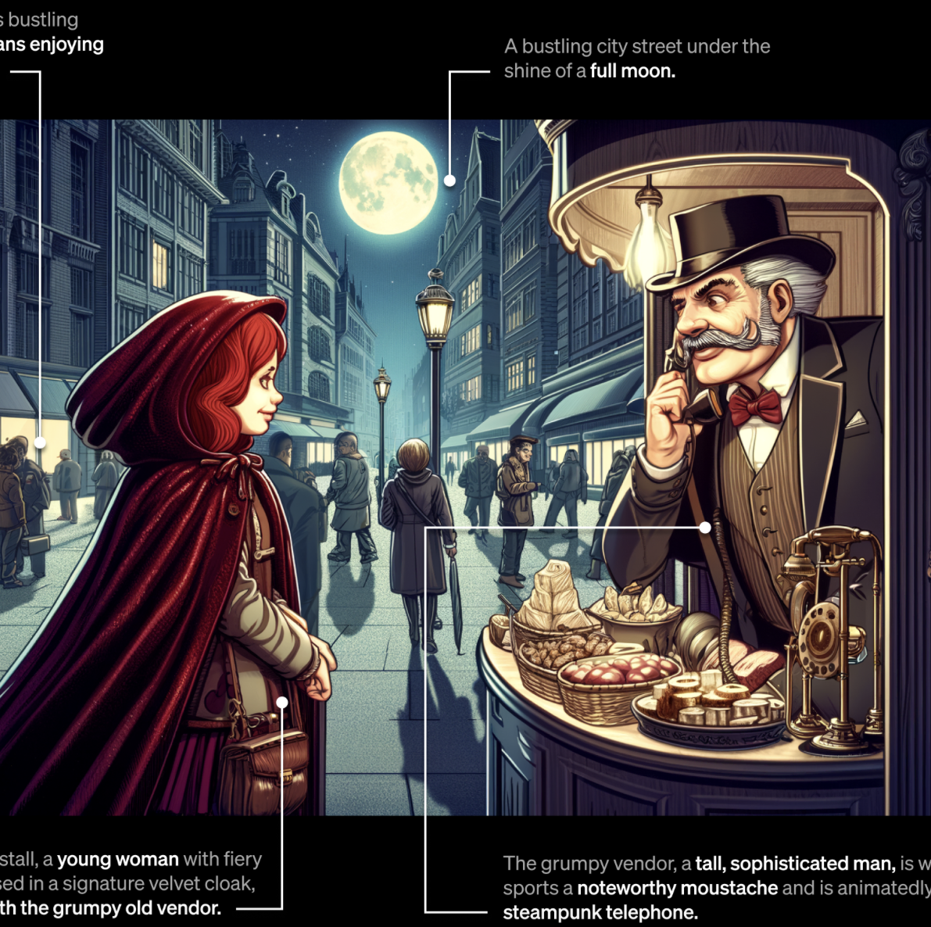
Text-to-image generation (DALL·E 3)
https://openai.com/dall-e-3

Slide 7

Image-to-video generation (Runway Gen-2)
https://www.youtube.com/watch?v=TUeVEWfFDTQ

Slide 8
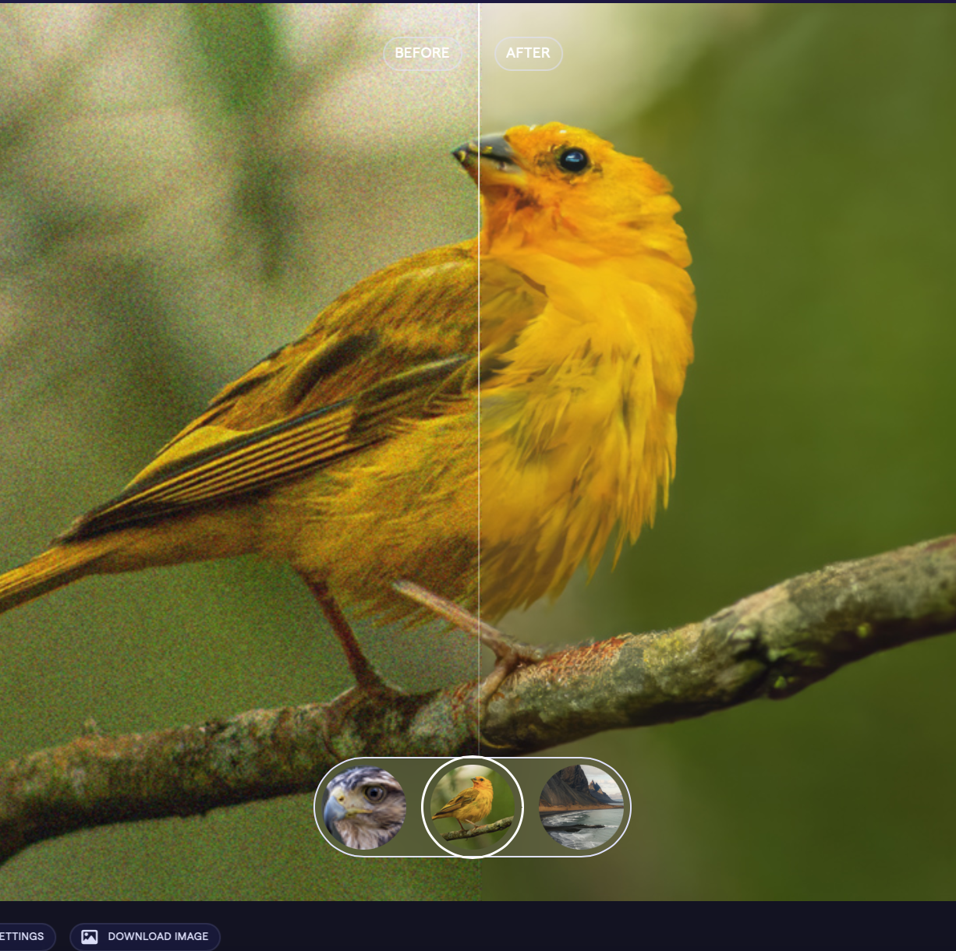
Improve resolution quality enhancement (Topaz Labs)
https://www.topazlabs.com/topaz-photo-ai

Slide 9
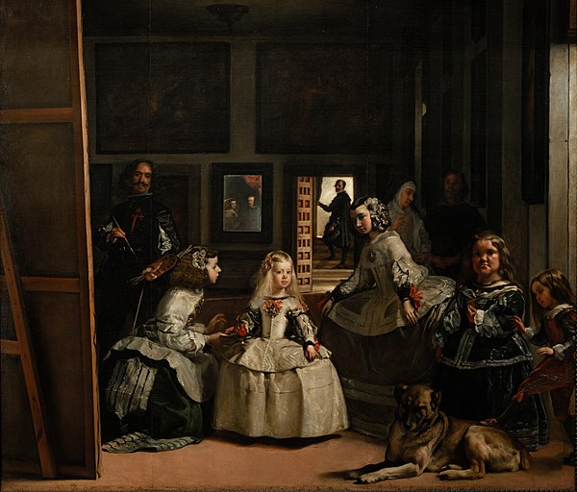
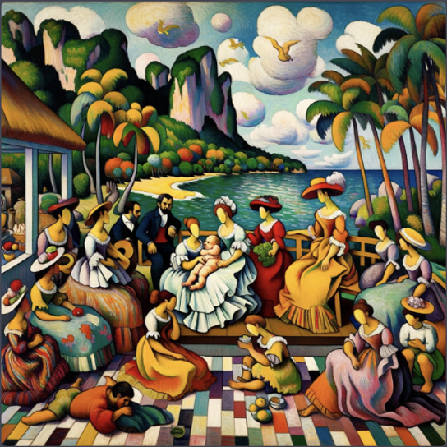
Style change (Las Meninas)
Diego Velázquez
Paul Gauguin

Slide 10
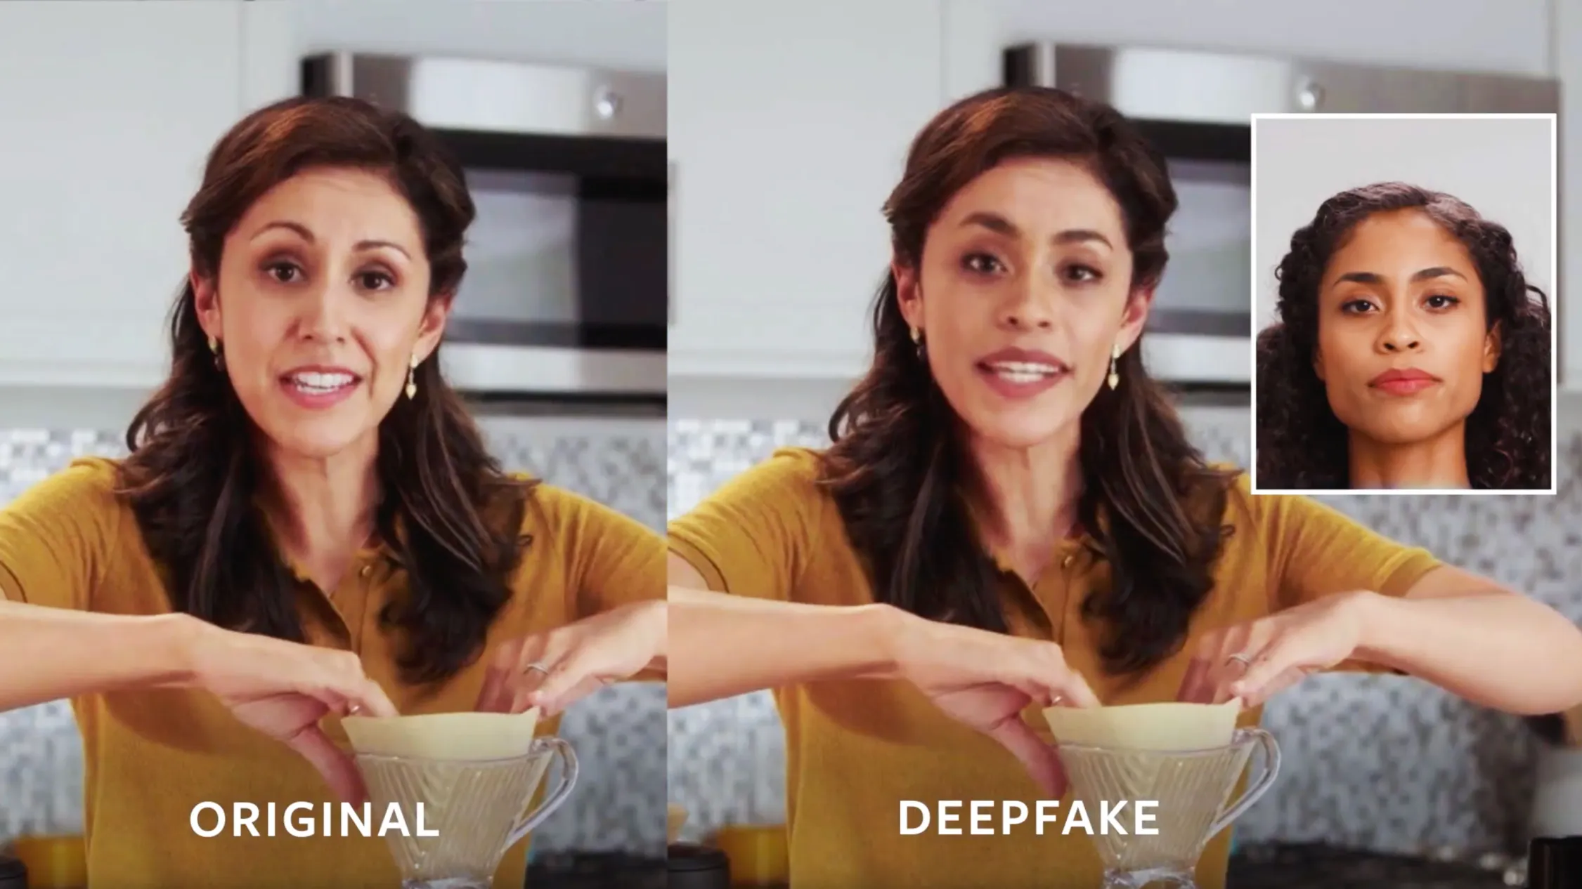
Deepfake
https://www.technologyreview.com/2019/09/05/65353/facebook-is-making-ai-deepfakes-to-head-off-a-disinformation-disaster/

Slide 11
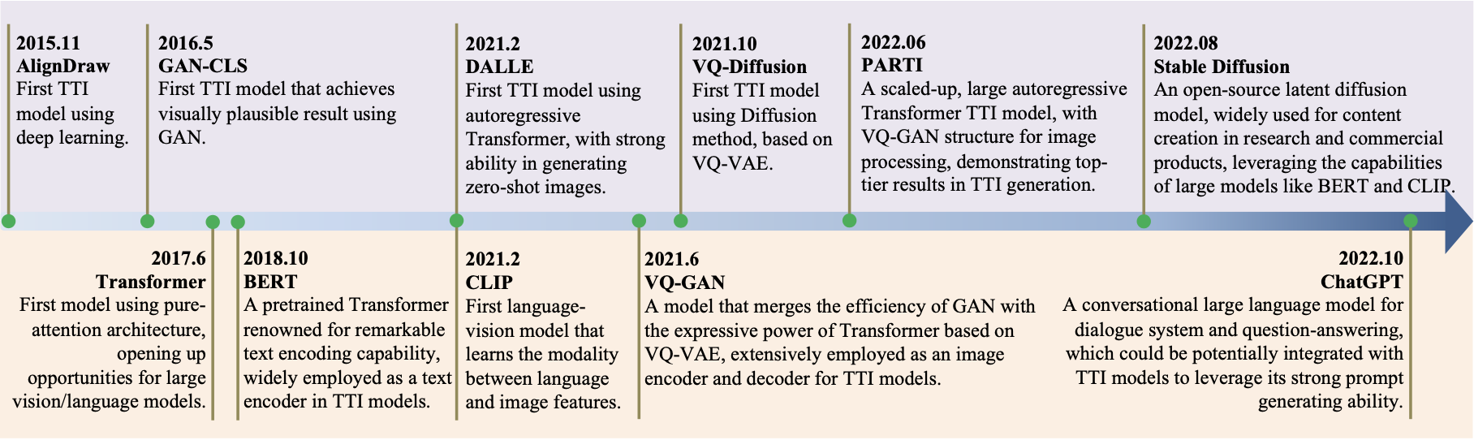
Current Development Trends
F. Bie et al., “RenAIssance: A Survey into AI Text-to-Image Generation in the Era of Large Model,” arXiv (Cornell University), Sep. 2023, doi: https://doi.org/10.48550/arxiv.2309.00810.

Slide 12
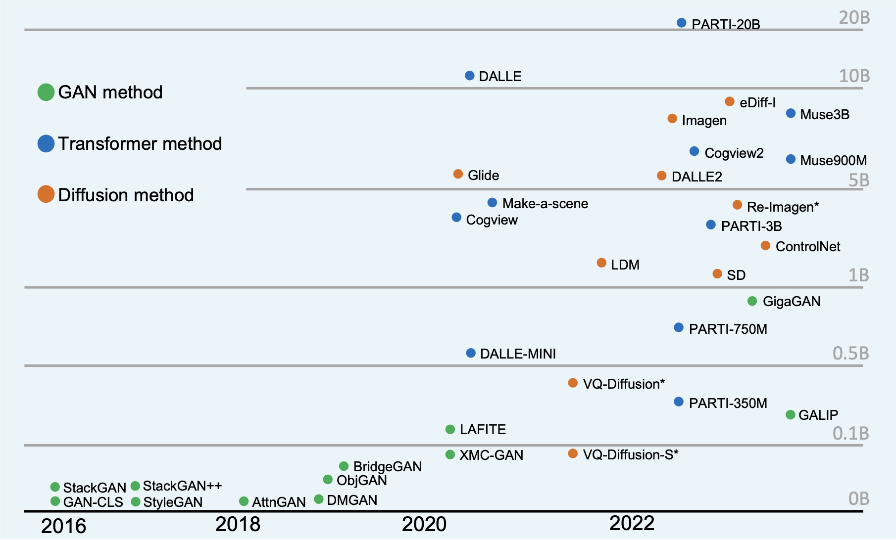
Current Development Trends
F. Bie et al., “RenAIssance: A Survey into AI Text-to-Image Generation in the Era of Large Model,” arXiv (Cornell University), Sep. 2023, doi: https://doi.org/10.48550/arxiv.2309.00810.

Slide 13
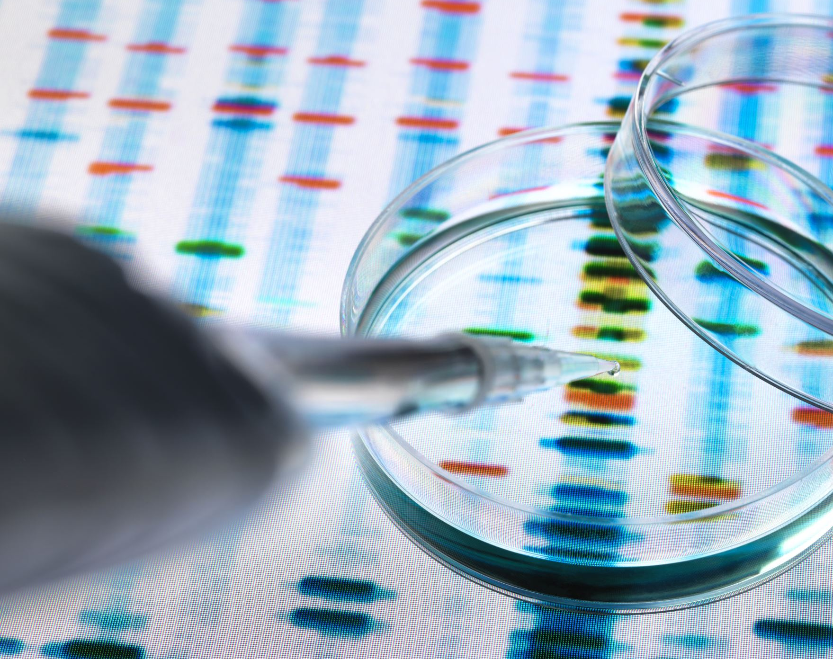
Methodologies

Slide 14
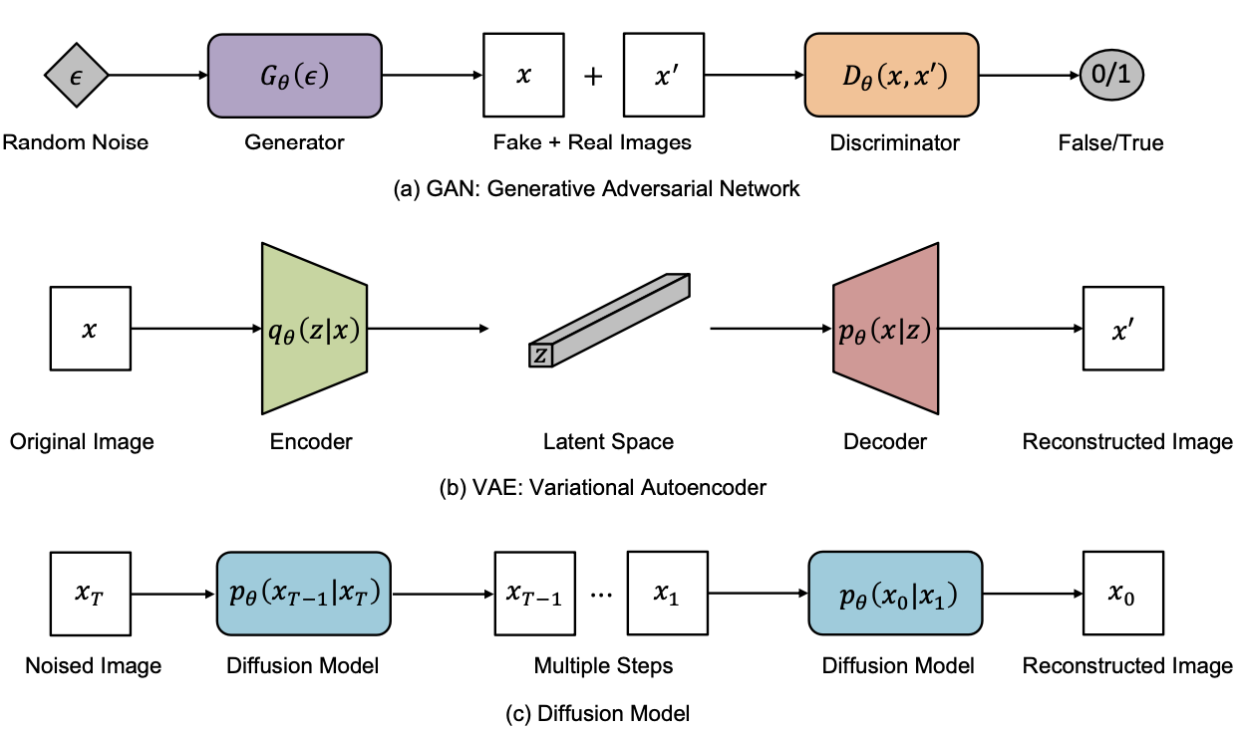
Overview of Generative Model Architectures

Slide 15
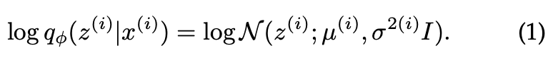
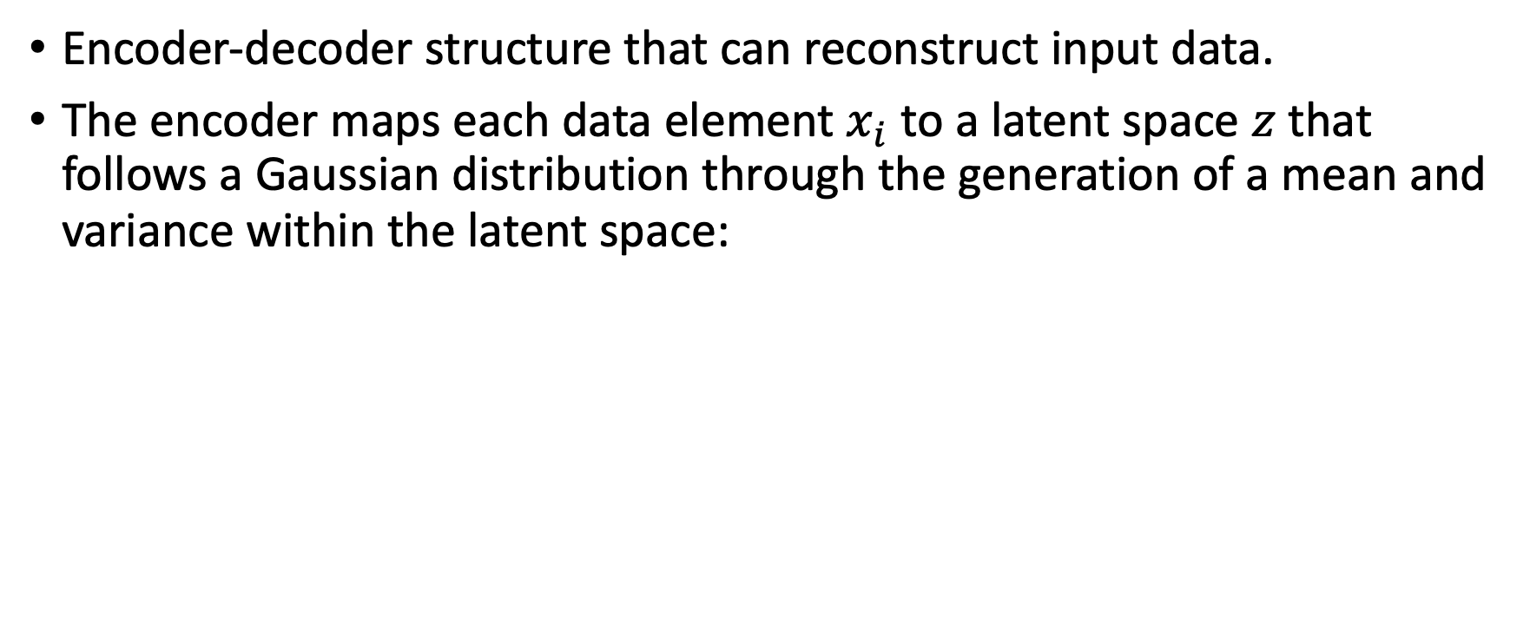
Variational Autoencoders (VAE)
Encoder-decoder structure that can reconstruct input data.
The encoder maps each data element $x_{i}$ to a latent space $z$ that follows a Gaussian distribution through the generation of a mean and variance within the latent space:

Slide 16
Variational Autoencoders (VAE)
The variance of the Gaussian distribution is critical in providing the generative quality as noises are incrementally introduced to the latent space. The encoder learns to predict the variance and mean of the distribution. However, this process here is not differentiable as we are sampling from a distribution that we are parameterizing. Thus, VAE makes use of a re-parameterization trick which separates the process of sampling and the prediction of the mean and variance:

Slide 17
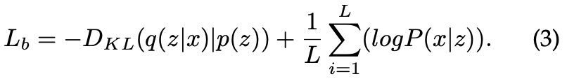
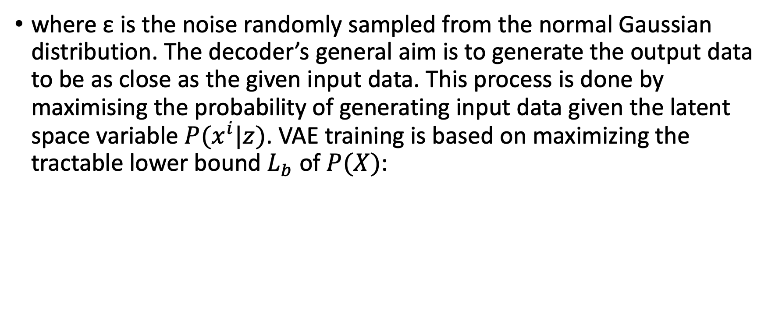
Variational Autoencoders (VAE)
where ε is the noise randomly sampled from the normal Gaussian distribution. The decoder’s general aim is to generate the output data to be as close as the given input data. This process is done by maximising the probability of generating input data given the latent space variable $P(x^{i}|z)$. VAE training is based on maximizing the tractable lower bound $L_{b}$ of $P(X)$:

Slide 18
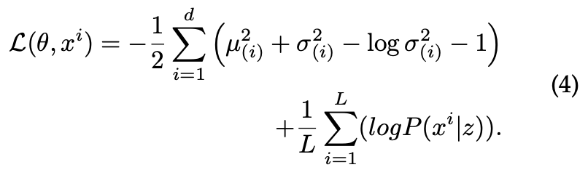
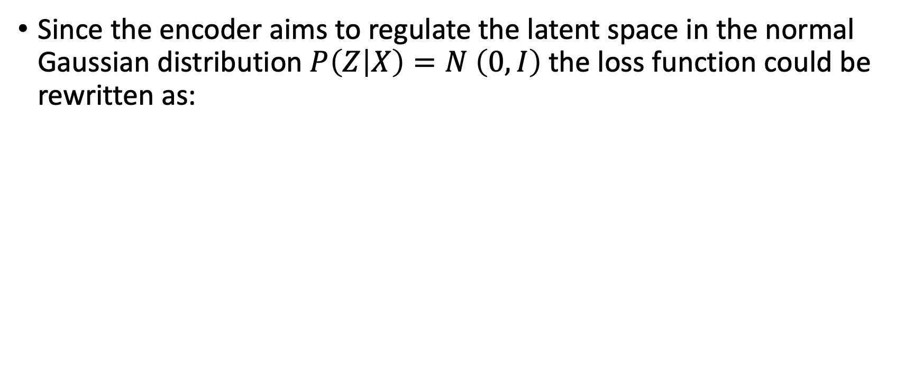
Variational Autoencoders (VAE)
Since the encoder aims to regulate the latent space in the normal Gaussian distribution $P\left(Z | X\right)=N \left(0, I\right)$the loss function could be rewritten as:

Slide 19
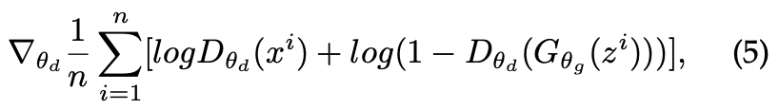
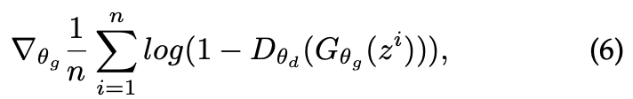
Generative Adversarial Networks (GANs)
GAN training process is based on the adversarial process with the minimax algorithm. This is achieved by either fixing the generator and taking gradient ascent on the discriminator:
Or fixing the discriminator and taking gradient descent on the generator:

Slide 20
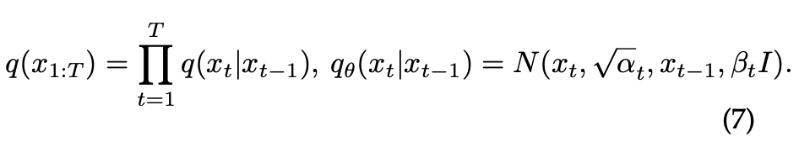
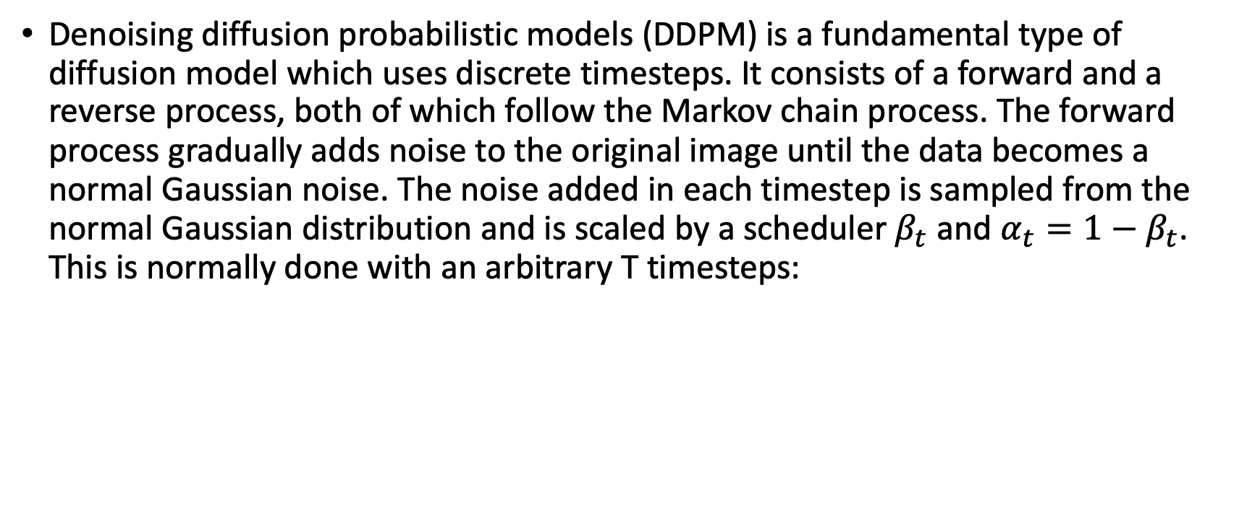
Diffusion Models
Denoising diffusion probabilistic models (DDPM) is a fundamental type of diffusion model which uses discrete timesteps. It consists of a forward and a reverse process, both of which follow the Markov chain process. The forward process gradually adds noise to the original image until the data becomes a normal Gaussian noise. The noise added in each timestep is sampled from the normal Gaussian distribution and is scaled by a scheduler $β_{t}$ and $α_{t}=1−β_{t}$. This is normally done with an arbitrary T timesteps:
And because of the addition property of the Gaussian distribution, it could be converted to:

Slide 21
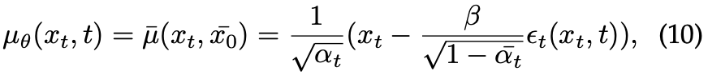
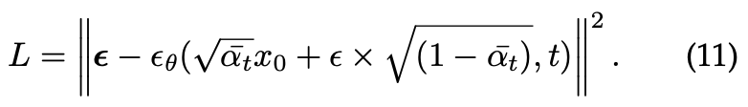
Diffusion Models
The reverse process is also a Markovian chain that samples the data from a learned Gaussian distribution at each timestep to remove the noise:
DDPM takes the variance as a fixed schedule guided by $β$ and calculates the mean value with the approximation of $x_{0}$ given $x_{t}$:
Training is based on the optimization of the variational upper bound, which could be reparameterized based on the form of Eq. (10):

Slide 22
Diffusion Models
The reverse process is also a Markovian chain that samples the data from a learned Gaussian distribution at each timestep to remove the noise:
DDPM takes the variance as a fixed schedule guided by $β$ and calculates the mean value with the approximation of $x_{0}$ given $x_{t}$:
Training is based on the optimization of the variational upper bound, which could be reparameterized based on the form of Eq. (10):

Slide 23
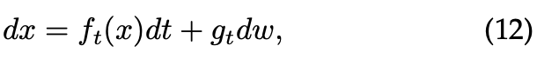
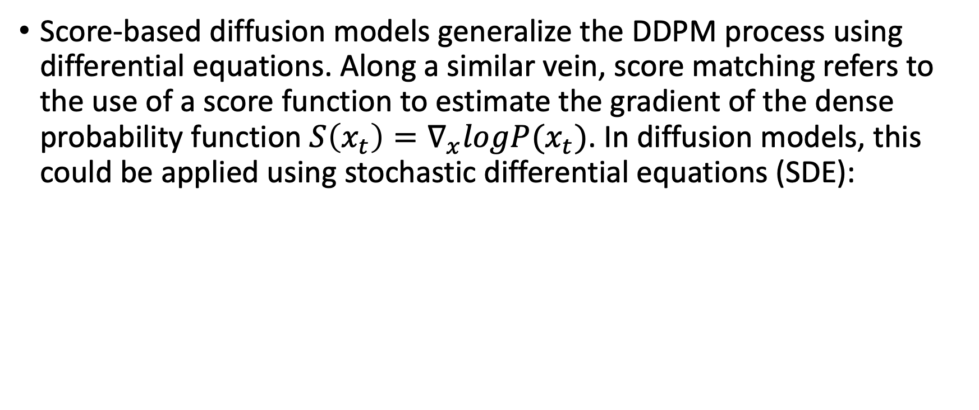
Diffusion Models
Score-based diffusion models generalize the DDPM process using differential equations. Along a similar vein, score matching refers to the use of a score function to estimate the gradient of the dense probability function $S\left(x_{t}\right)=∇_{x}logP(x_{t})$. In diffusion models, this could be applied using stochastic differential equations (SDE):

Slide 24
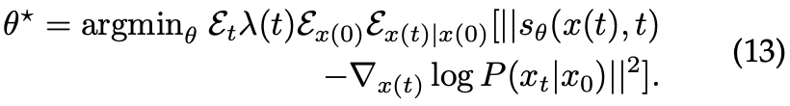
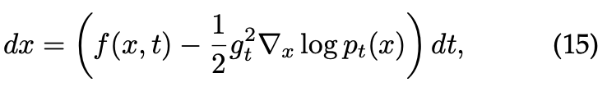
Diffusion Models
SDE diffusion model takes the denoising score matching approach via continuous time generalization of the DDPM loss function to train the score model:
The reverse process also matches a diffusion process, yielding the result of:
Such reverse process could alternatively be represented by an ordinary differential equation (ODE):

Slide 25
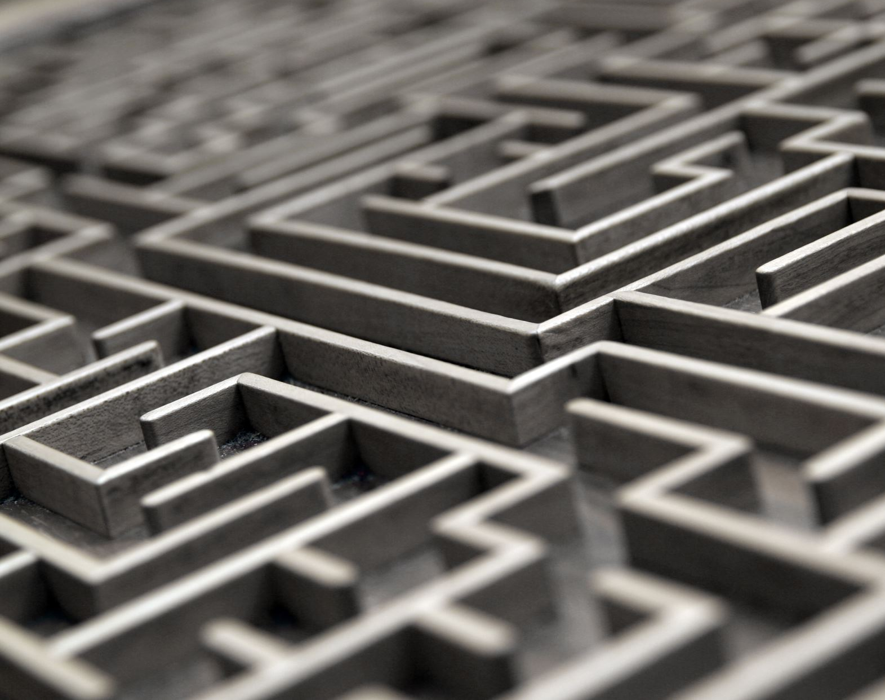
Challenges

Slide 26
Challenges: Computational Issues
High Computational Costs: Intensive resource requirements for training and inference.
Scalability: Limitations in handling large-scale datasets or high-resolution media.
Energy Efficiency: Concerns about the environmental impact of AI computations.
Real-Time Processing: Challenges in meeting real-time requirements for applications like live streaming or video conferencing.

Slide 27
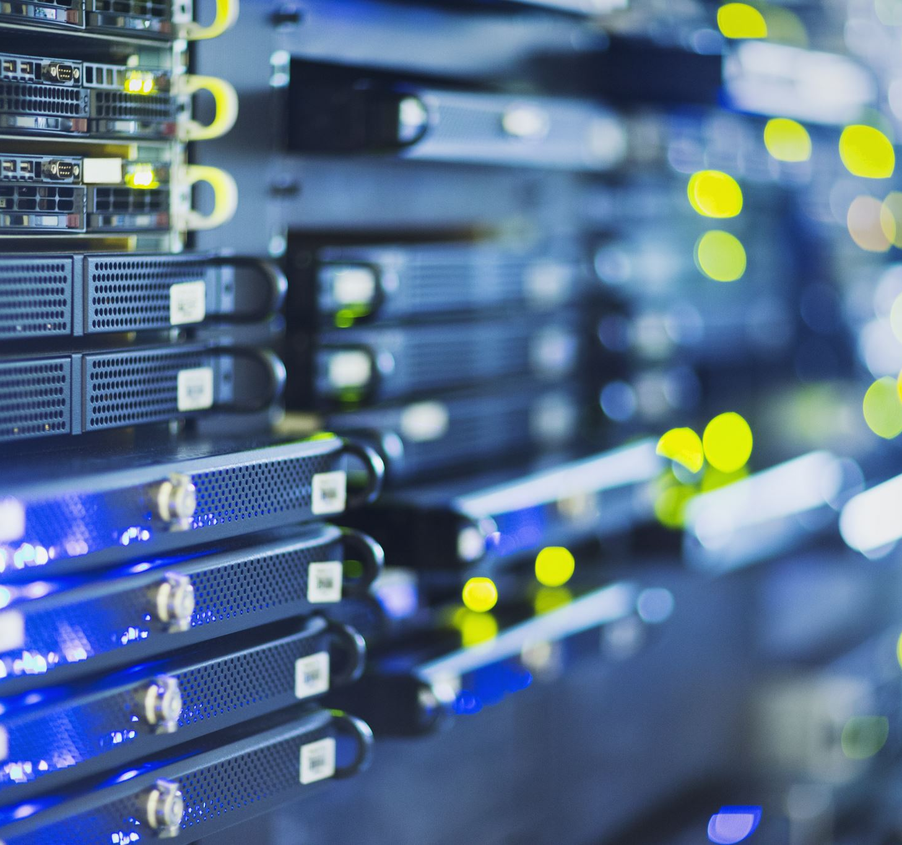
Challenges: Computational Issues
Hardware Dependence: Need for specialized hardware like GPUs for optimum performance.
Algorithm Complexity: The trade-off between performance and computational overhead.
Data Storage: Requirement for extensive storage solutions for training and generated media.

Slide 28

Challenges: Ethical Dilemmas
Deepfakes: Risks of misinformation and identity theft.
Bias and Fairness: The perpetuation of stereotypes through AI algorithms.
Consent: Ethical implications of generating images or videos of individuals without their explicit consent.
Data Privacy: Risks associated with the use and storage of personal data for training models.

Slide 29
Challenges: Ethical Dilemmas
Intellectual Property: Concerns over the originality and ownership of AI-generated content.
Accountability: Determining responsibility for actions taken by AI systems.
Transparency: The need for explainable AI and understanding how decisions are made.

Slide 30

Challenges: Video Consistency
Frame-to-Frame Consistency: Ensuring visual elements remain stable across consecutive frames.
Temporal Coherence: Maintaining the integrity of dynamic scenes over time.
Object Tracking: Difficulties in consistently identifying and following objects throughout a video.

Slide 31
Challenges: Video Consistency
Color and Lighting: Challenges in maintaining consistent color grading and lighting conditions.
Audio-Visual Sync: Ensuring that generated videos are in sync with any accompanying audio.
Context Preservation: Maintaining background and other contextual elements consistently across frames.
Real-time Adaptability: The ability to adapt to new data or changes in the scene in real-time without loss of consistency.

Slide 32

Future Directions

Slide 33
Future Development Trend
High-Fidelity: Movement towards higher resolution and detail (Latent Diffusion Models).
Beyond 2D: Extension into 3D objects and functional machines (Neural Cellular Automata).
Real-Time Efficiency: Algorithms for faster processing (Skip-Convolutions).
Ethical Considerations: Bias mitigation, preventing malicious use of AI-generated deepfakes.
Unified Solutions: Research towards integrating different techniques (keyframe propagation models).

Slide 34
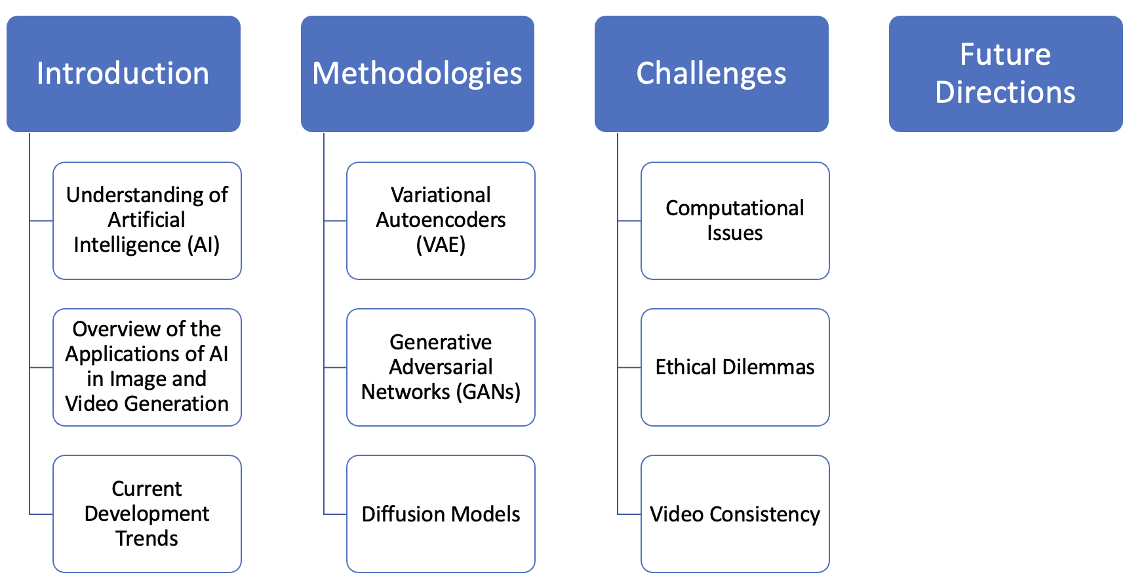
Conclusion

Slide 35
References
https://openai.com/dall-e-3
https://www.topazlabs.com/topaz-photo-ai
https://www.technologyreview.com/2019/09/05/65353/facebook-is-making-ai-deepfakes-to-head-off-a-disinformation-disaster/
F. Bie et al., “RenAIssance: A Survey into AI Text-to-Image Generation in the Era of Large Model,” arXiv (Cornell University), Sep. 2023, doi: https://doi.org/10.48550/arxiv.2309.00810.
D. J. Rezende, S. Mohamed, and D. Wierstra, “Stochastic back- propagation and approximate inference in deep generative mod- els,” in ICML. PMLR, 2014, pp. 1278–1286.
D. P. Kingma and M. Welling, “Auto-encoding variational bayes,” arXiv preprint arXiv:1312.6114, 2013.
K. Cho, B. van Merrienboer, D. Bahdanau, and Y. Bengio, “On the properties of neural machine translation: Encoder–decoder approaches,” in Proceedings of SSST-8, Eighth Workshop on Syntax, Semantics and Structure in Statistical Translation. Association for Computational Linguistics, 2014, p. 103.
I. Goodfellow, J. Pouget-Abadie, M. Mirza, B. Xu, D. Warde- Farley, S. Ozair, A. Courville, and Y. Bengio, “Generative adver- sarial nets,” NeurIPS, vol. 27, 2014.
J. Ho, A. Jain, and P. Abbeel, “Denoising diffusion probabilistic models,” NeurIPS, vol. 33, pp. 6840–6851, 2020.
P. Dhariwal and A. Nichol, “Diffusion models beat gans on image synthesis,” NeurIPS, vol. 34, pp. 8780–8794, 2021.
Y. Song, J. Sohl-Dickstein, D. P. Kingma, A. Kumar, S. Ermon, and B. Poole, “Score-based generative modeling through stochastic differential equations,” arXiv preprint arXiv:2011.13456, 2020.
B. D. Anderson, “Reverse-time diffusion equation models,” Stochastic Processes and their Applications, vol. 12, no. 3, pp. 313–326, 1982.

Slide 36

Thank you!

